Slide 1


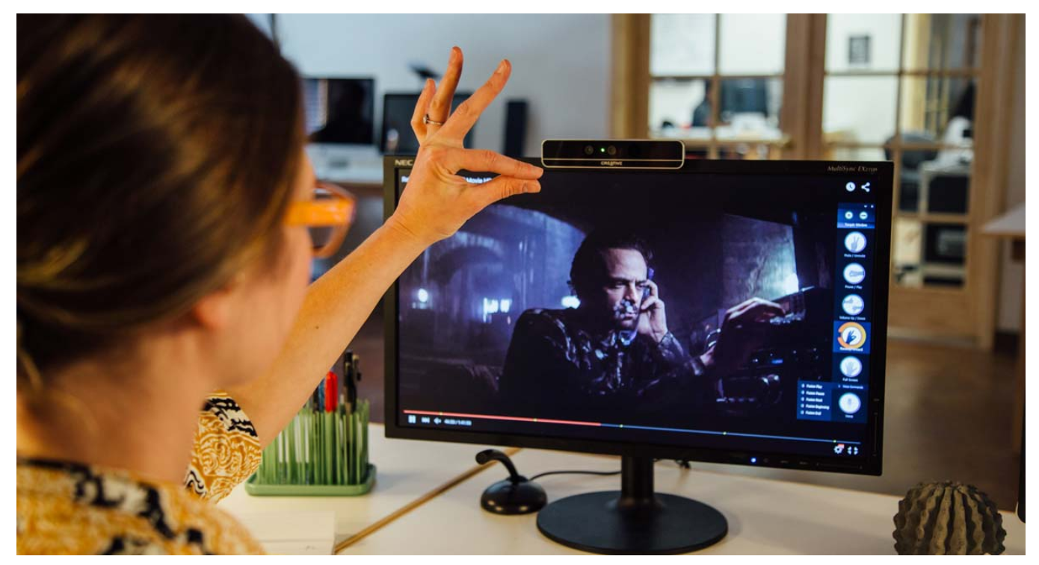
TOUCH ME NOT
Team Members
-Deepesh Sonigra
-Madhumitha Tolakanahalli

Slide 2
CONTENTS
INTRODUCTION
FUNCTIONAL CAPABILITIES
HARDWARE BLOCK DIAGRAM
SOFTWARE BLOCK DIAGRAM
FLOWCHART
DATA FLOW DIAGRAM
REAL TIME REQUIREMENTS
PERFORMANCE REQUIREMENTS
PROOF OF CONCEPT ANALYSIS
DEMO

Slide 3
INTRODUCTION
“TOUCH ME NOT” is a real time gesture recognition tool which can detect and count number of raised fingers.
With keeping in mind the present situation of COVID-19, the tool can fulfill the requirement of a touchless user interface.
This tool can be used to create a touchless interface with any computer system with a camera capability and a screen.
We have created a touchless feedback system for a restaurant as one of the applications for this system.
Notes:
Gesture recognition tool
The motivation for this tool – Covid 19 – touchless interfaces
Can be extended to any application
Cost effective – any display and a camera
Here, feedback for a restaurant

Slide 4

FUNCTIONAL CAPABILITIES
HAND DETECTION
Capability to detect a hand of a user to process the gesture
FINGER DETECTION
Capability to detect the number of fingers as indicated by the user
UI
A display on the screen for the user interface.

Slide 5
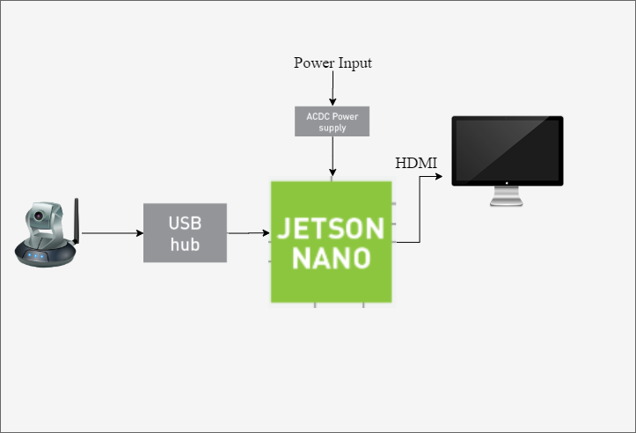
HARDWARE BLOCK DIAGRAM
Hardware Components:
DC Power Supply (5V , 2A)
Jetson Nano
Logitech C270 Camera 12MP
Monitor(HDMI)

Slide 6
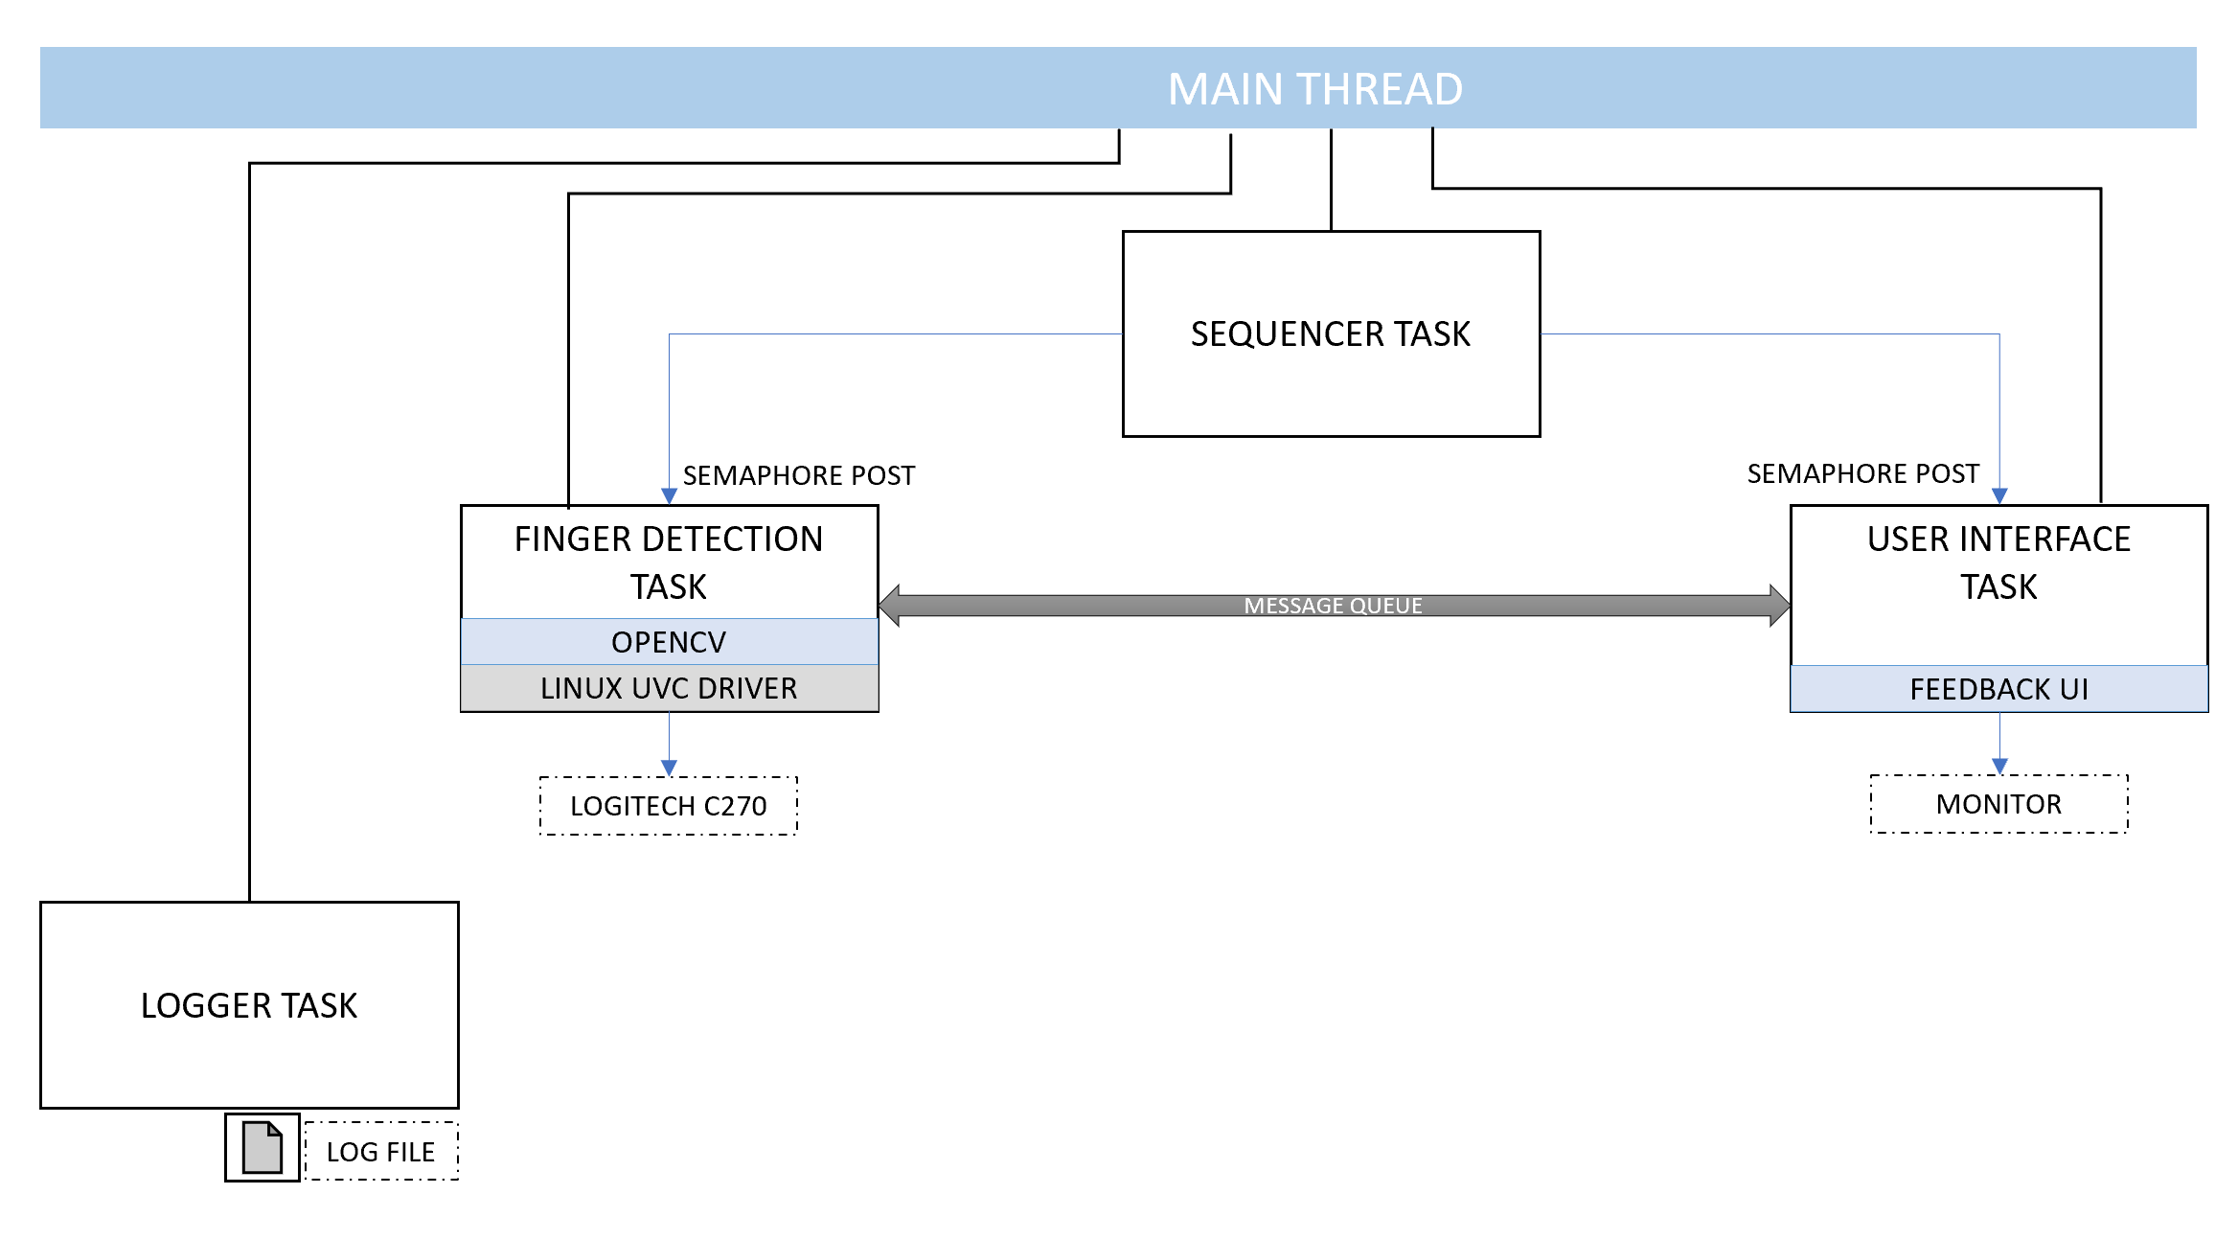
SOFTWARE BLOCK DIAGRAM
Software Components:
Linux4Tegra (OS)
OpenCV
Notes:
The sequencer schedules the tasks based on their period
(Inspiration – Exercise 5)
SEQUENCER 10HZ
HAND 10HZ
UI 2HZ

Slide 7
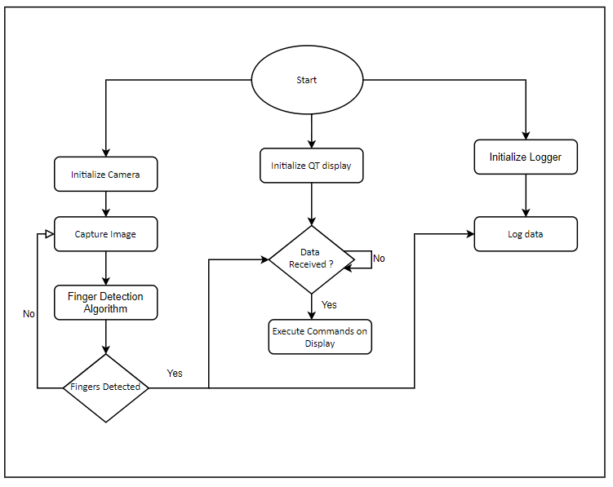
FLOWCHART
The scheduler schedules 2 tasks based on their periods.
The camera task captures the image, performs detection algorithm
The Camera task communicates the option selected by the user to the UI task.
The Logger task logs all these events and information captured and sent
The Display task moves on to another display.

Slide 8
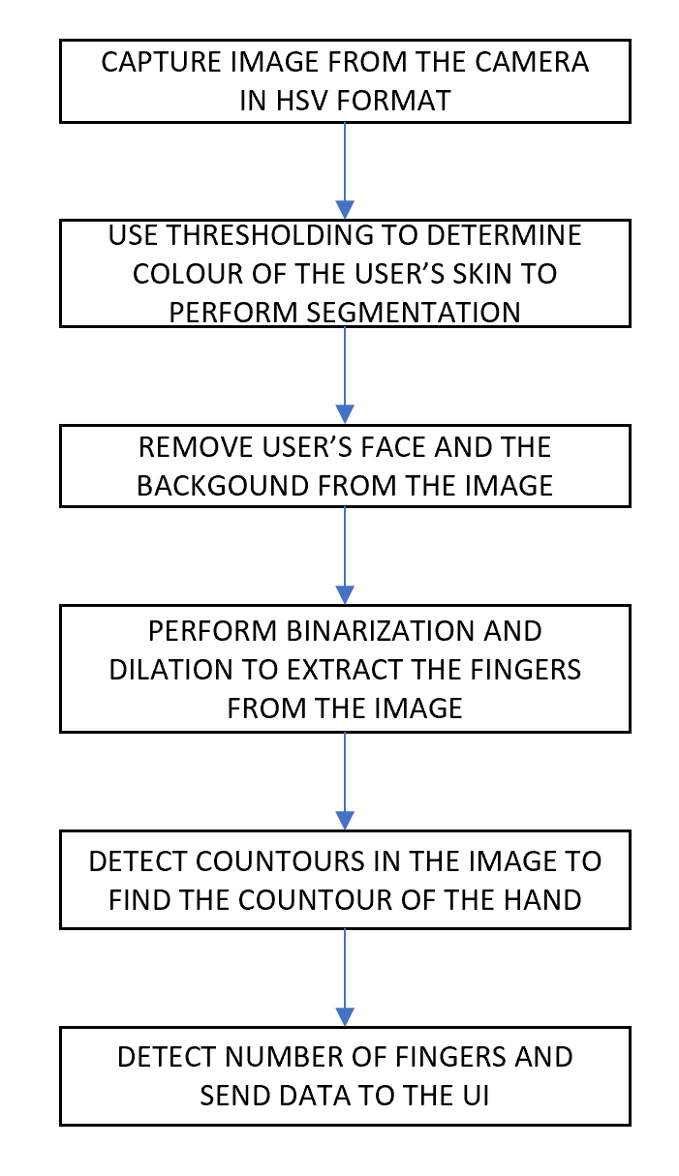
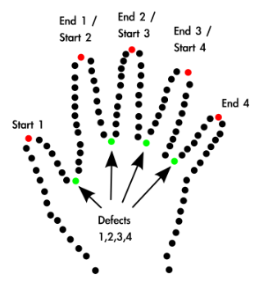
DATA FLOW DIAGRAM

Slide 9
REAL-TIME REQUIREMENTS
The response time of the system should be around 1 second of the user gesturing.
The User Interface should update within 1 second after the feedback has been detected and displayed.
The hand detection task should perform detection and approximation of the fingers detected within 0.5 seconds.
The Display Task should update the option selected within 0.5 seconds.
Notes:
The response time of the system should be around 1 second of the user gesturing.
Response is split as :
0.5 seconds for hand and 0.5 seconds for UI update

Slide 10
WCET OF SERVICES
TASK | PERIOD | PRIORITY | WCET | DEADLINE | FREQUENCY
SEQUENCER | 100ms | MAX - 1 | 0.034ms | 100ms | 10Hz
HAND DETECTION | 100ms | MAX - 2 | 70.4ms | 100ms | 10Hz
USER INTERFACE | 500ms | MAX - 3 | 38.86ms | 500ms | 2Hz

Slide 11
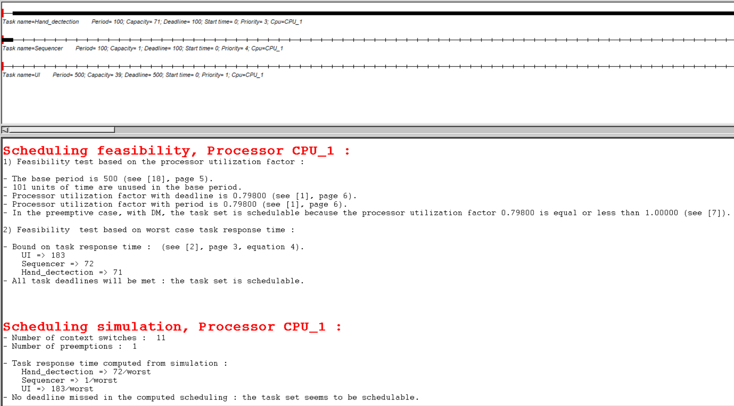
CHEDDAR ANALYSIS
All tasks deadline will be met
The services seems to be feasible and schedulable
The processor utilization factor is 0.79800

Slide 12
PERFORMANCE REQUIREMENTS
The tasks are scheduled using Rate Monotonic Scheduling Algorithm assigning highest priority to task with least period.
The period and deadline of the tasks has been calculated with an additional safety margin considering the worst-case execution of the tasks.
The safety margin for the system for 500ms is around 119ms where 500ms is the LCM of the periods of the tasks.
This safety margin accounts for logging and interference time for the tasks.
Notes:
Safety margin was selected

Slide 13
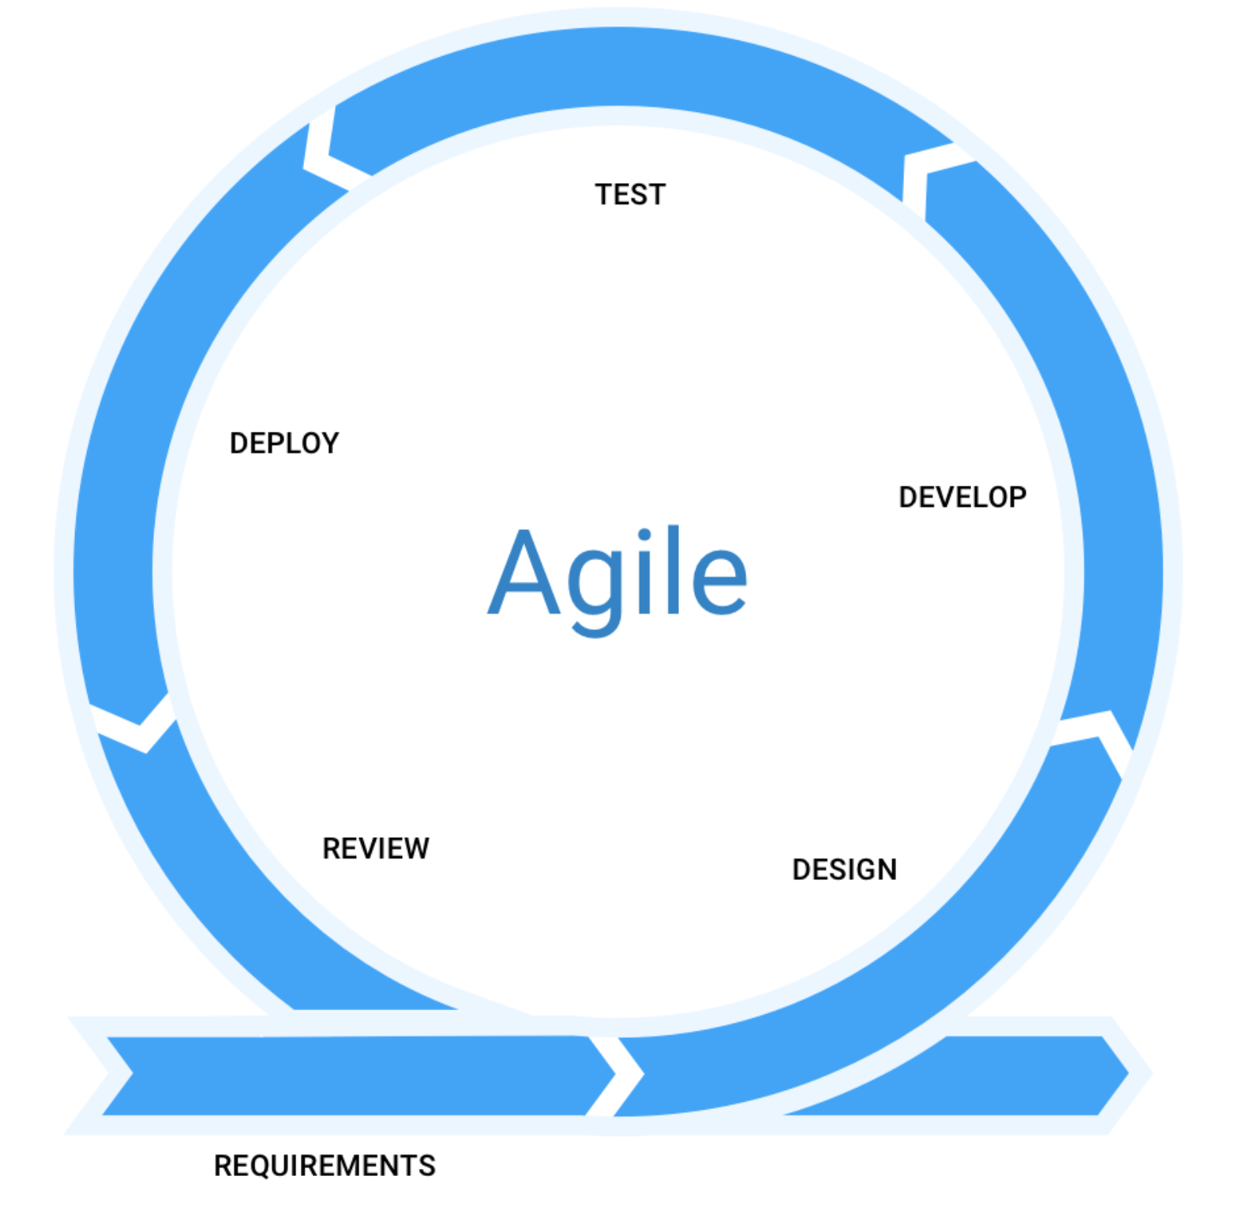
TESTING AND SDLC – AGILE MODEL
Iteration based
Short Feedback Loop
Collaboration
Constant researching
Unit Testing and System Testing
Notes:
Used the Agile Model
The development was done incrementally with the addition of each requirement.
Each delta change went through the cycle of design, development, testing and review
Iteration based
Short Feedback Loop – easier to identify bugs
Collaboration -
Constant researching
Unit Testing and System Testing

Slide 14
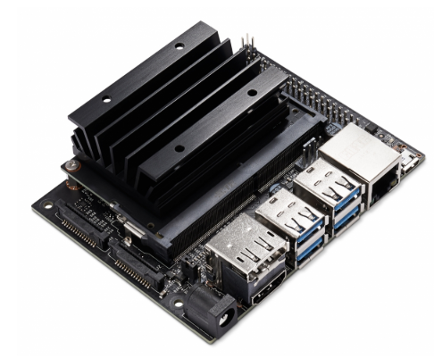
PROOF OF CONCEPT ANALYSIS
PLATFORM RESOURCES
JETSON NANO
CPU Quad Core ARM A57 @ 1.43GHz
GPU 128-core Maxwell
Memory 4GB 64-bit LPDDR4 25.6GB/s
Storage microSD Card 64GB
Video Encode 4K @ 30 | 4x 1080p @ 30 | 9x 720p @ 30 (H.264/H.265) Video Decode 4K @ 60 | 2x 4K @ 30 | 8x 1080p @ 30 | 18x 720p @ 30
Camera 2x MIPI CSI-2 DPHY lanes
Connectivity Gigabit Ethernet, M.2 Key E
Display HDMI and Display Port

Slide 15
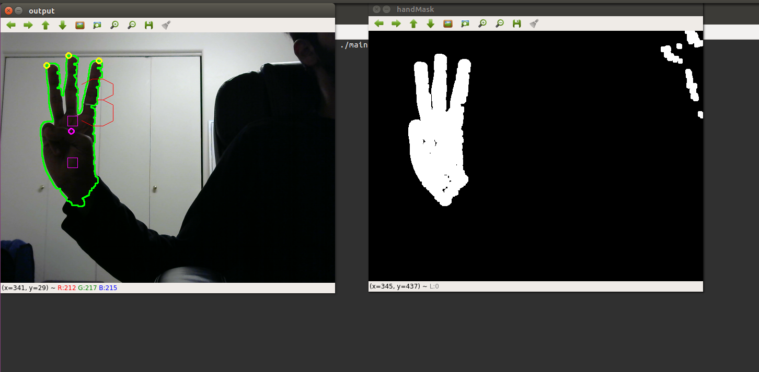
PROOF OF CONCEPT ANALYSIS (CONTD) IMPLEMENTATION OF KEY SERVICES
The hand detection is done by detecting the contours in the binary image containing the hand.
This is done by performing hand segmentation and background elimination of the image
The fingertips are detected by finding the intersection points of the contour and the convex hull.
Approximation is done on the dataset and the option is sent to UI task

Slide 16
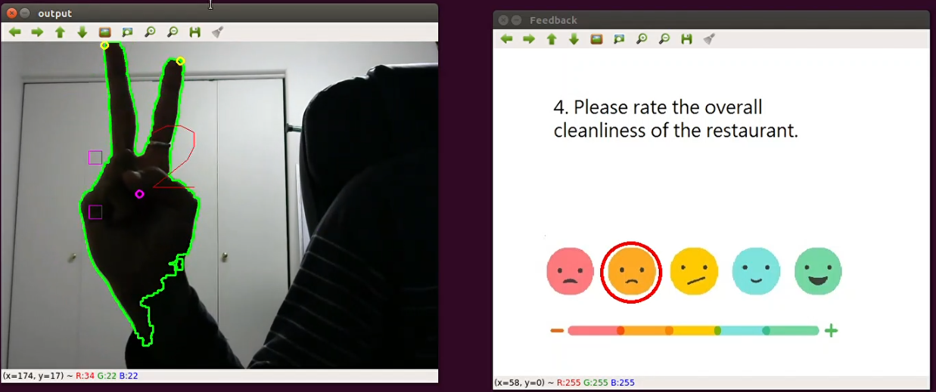
PROOF OF CONCEPT ANALYSIS (CONTD) IMPLEMENTATION OF KEY SERVICES
The UI Task receives messages from the Hand detection task through non-blocking message queues.
Once it receives the message it disables the message queue and updates the display accordingly.
The circle is drawn around the option selected, and display is updated and enables the message queue.
Notes:
Why disable and enable message queues – avoid false positives

Slide 17
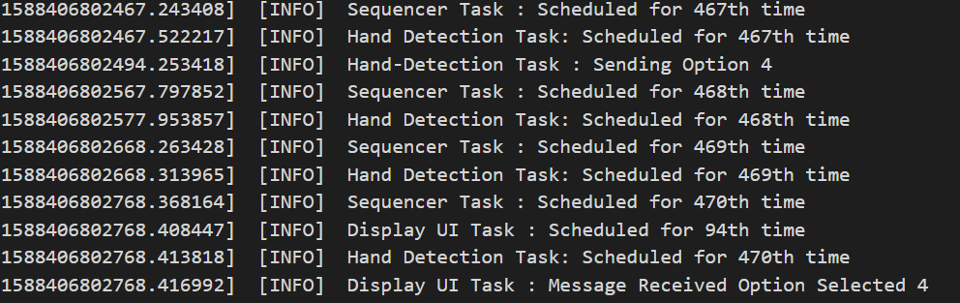
PROOF OF CONCEPT ANALYSIS (CONTD) TIME STAMP TRACING

Slide 18
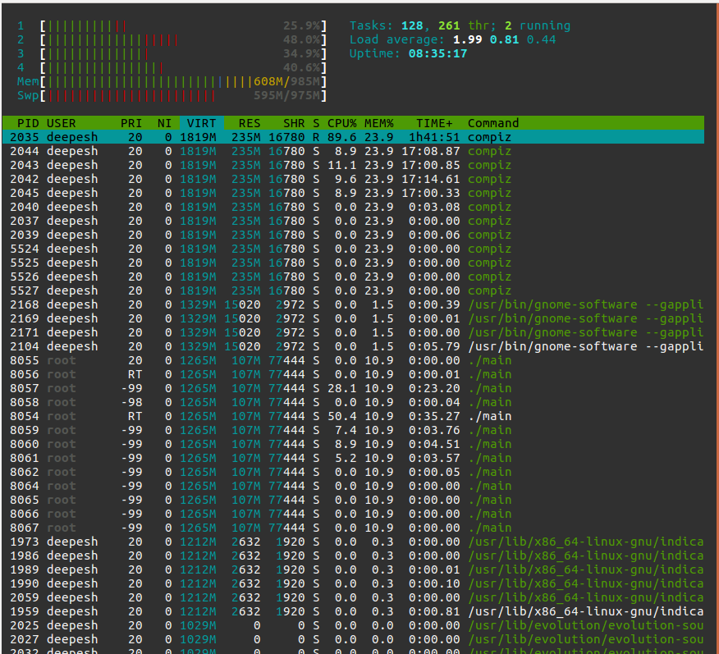
PROOF OF CONCEPT ANALYSIS (CONTD) PROFILING
The process is almost evenly distributed on all cores
CPU – 1 : 26%
CPU – 2 : 48 %
CPU – 3 : 34 %
CPU – 4 : 40 %

Slide 19
DEMO

Slide 20
LESSONS LEARNT
Gained significant knowledge about real-time scheduling and analysis.
Learnt to use the sequencer to schedule periodic tasks of varying priorities.
Gained a better understanding of OpenCV and its APIs.
Gained considerable experience in performing more complex image processing functions like contour detection.

Slide 21

QUESTIONS

Slide 22
THANK YOU

